Slide 1

Network Models &
Protocol Architectures
Lecture 1 | CSE421 – Computer Networks
Department of Computer Science and Engineering
School of Data & Science

Slide 2
Objectives
Layering in communication
Protocols
Standards
Protocol Suites
  OSI Model
  TCP/IP Model
Addressing

Slide 3
Layering
Tasks of communication are broken up into layers
Communication
Layer 1
Layer 2
Layer 3

Slide 4


Layers: Sending a letter
The letter is written, put in an envelope, and dropped in a mailbox.
The letter is picked up, removed from the envelope, and read.
Higher layers
The letter is carried from the mailbox to a post office.
The letter is carried from the post office to the mailbox.
Middle layers
The letter is delivered to a carrier by the post office
The letter is received from the carrier to the post office.
Lower layers
The parcel is carried from
the source to the destination

Slide 5
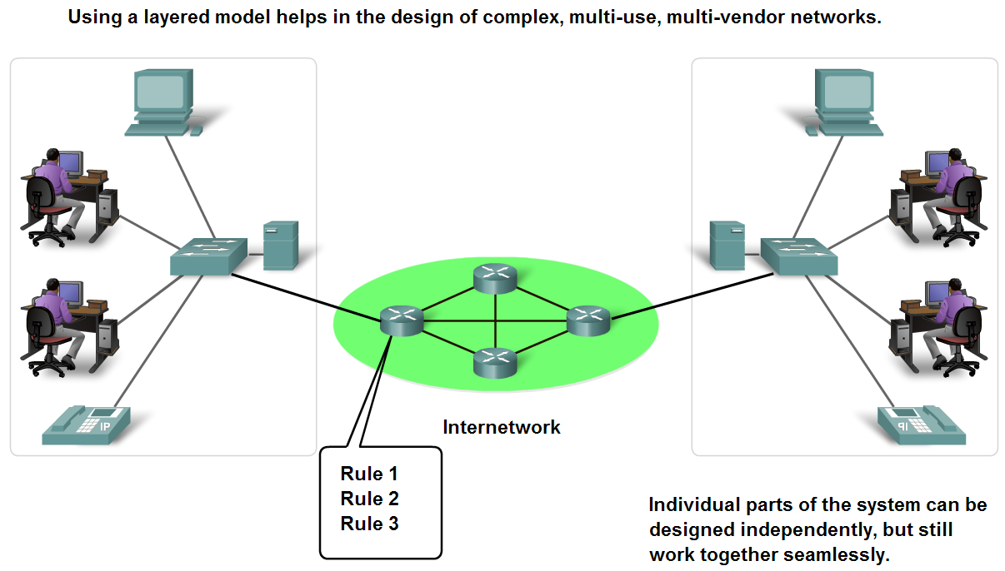
Benefits of using a layered model
Fosters competition.
Technology changes in one layer do not affect other layers.
Each layer have defined functions that they act upon.

Slide 6
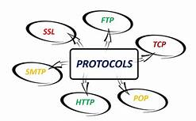
Protocols

Slide 7
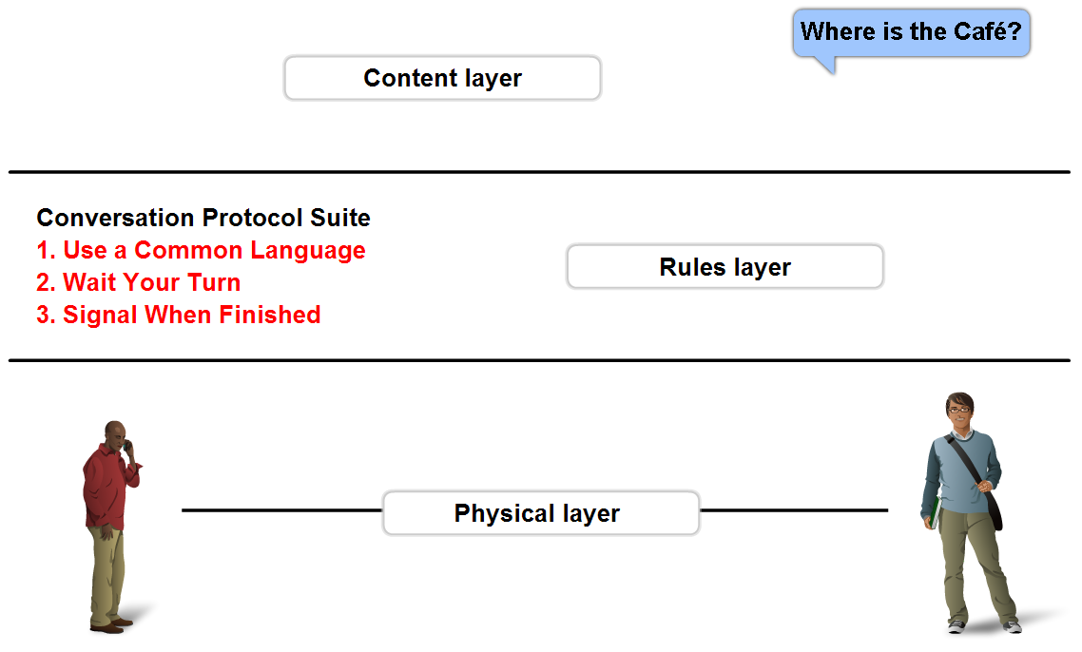
Protocols
All communications are governed by protocols
Protocols are the rules that communications will follow.
These rules will vary depending on the protocol.

Slide 8
Protocols
Protocols must account for the following requirements:
  An identified sender and receiver
  Common language and grammar
  Speed and timing of delivery
  Confirmation or acknowledgment requirements
Common computer protocols must agree in:
  Message encoding
  Message formatting and encapsulation
  Message size, timing, delivery option.

Slide 9

Standards

Slide 10
Standards
Standards
Standards Organizations
Internet Standards

Slide 11
Standards
Endorsed by the networking industry and approved by a standards organization.
Benefits:
  Create and maintain an open and competitive market.
  Ensured greater compatibility and interoperability.
Categories
  De facto – TCP/IP Protocol Model
  De jure – OSI Reference Model

Slide 12

Open Standards
Open standards encourage:
  Interoperability
  Competition
  Innovation
Standards organizations are:
  vendor-neutral
  non-profit organizations
  established to develop and promote the concept of open standards.

Slide 13
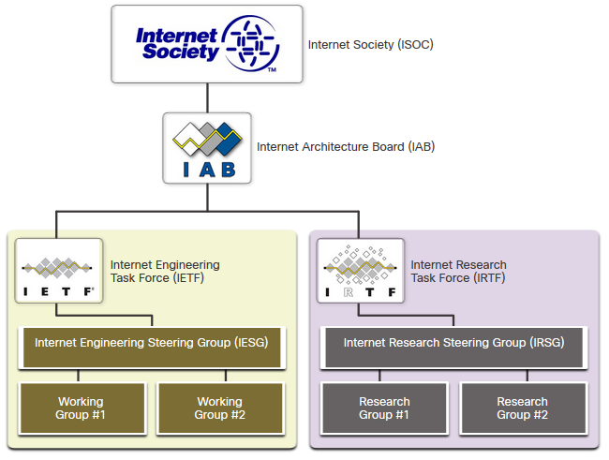
Internet Standards
Internet Society (ISOC) - Promotes the open development and evolution of internet
Internet Architecture Board (IAB) - Responsible for management and development of internet standards
Internet Engineering Task Force (IETF) - Develops, updates, and maintains internet and TCP/IP technologies
Internet Research Task Force (IRTF) - Focused on long-term research related to internet and TCP/IP protocols

Slide 14
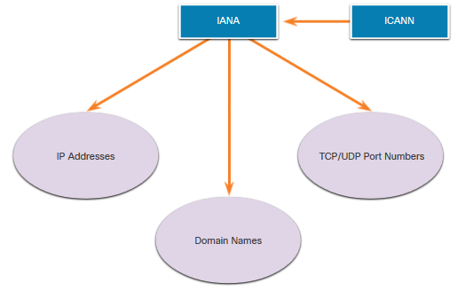
Internet Standards (Continued)
Standards organizations involved with the development and support of TCP/IP
  Internet Corporation for Assigned Names and Numbers (ICANN) - Coordinates IP address allocation, the management of domain names, and assignment of other information
  Internet Assigned Numbers Authority (IANA) - Oversees and manages IP address allocation, domain name management, and protocol identifiers for ICANN

Slide 15
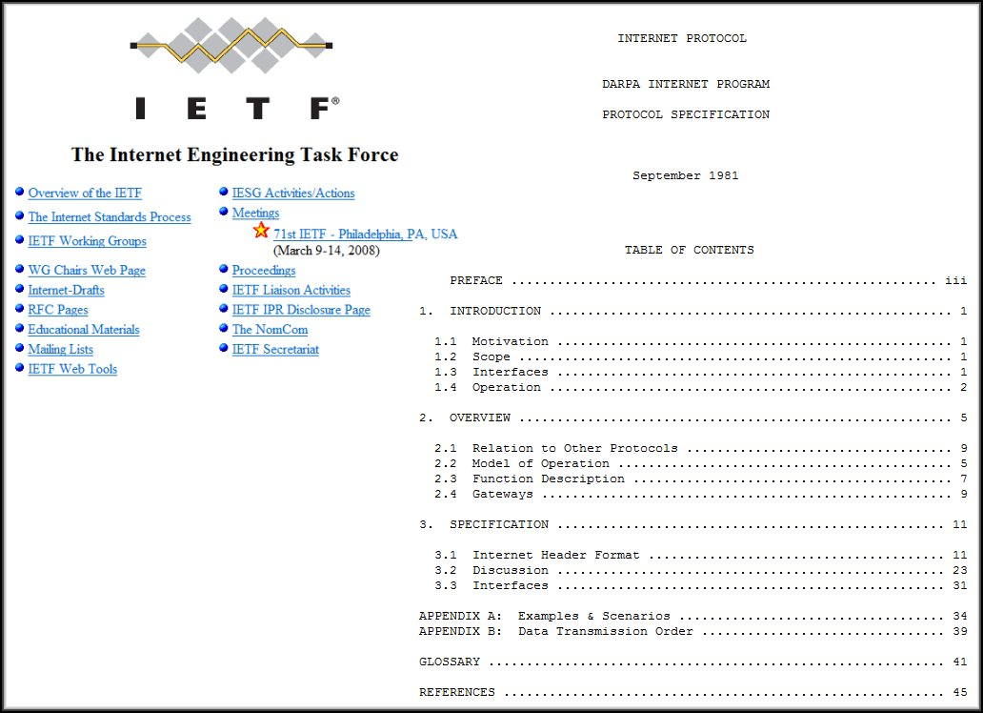
Internet Standards (Continued)
Formalized regulations and specifications for the Internet by IETF.
Internet Draft
  No official status
  6 month lifetime
Request for comment (RFC)
  Upon recommendation from Internet authorities
  Different maturity levels
  Example: Internet Protocol – RFC : 791

Slide 16
Electronic and Communications Standards
Institute of Electrical and Electronics Engineers (IEEE, pronounced “I-triple-E”) - dedicated to creating standards in power and energy, healthcare, telecommunications, and networking
Electronic Industries Alliance (EIA) - develops standards relating to electrical wiring, connectors, and the 19-inch racks used to mount networking equipment
Telecommunications Industry Association (TIA) - develops communication standards in radio equipment, cellular towers, Voice over IP (VoIP) devices, satellite communications, and more
International Telecommunications Union-Telecommunication Standardization Sector (ITU-T) - defines standards for video compression, Internet Protocol Television (IPTV), and broadband communications, such as a digital subscriber line (DSL)

Slide 17
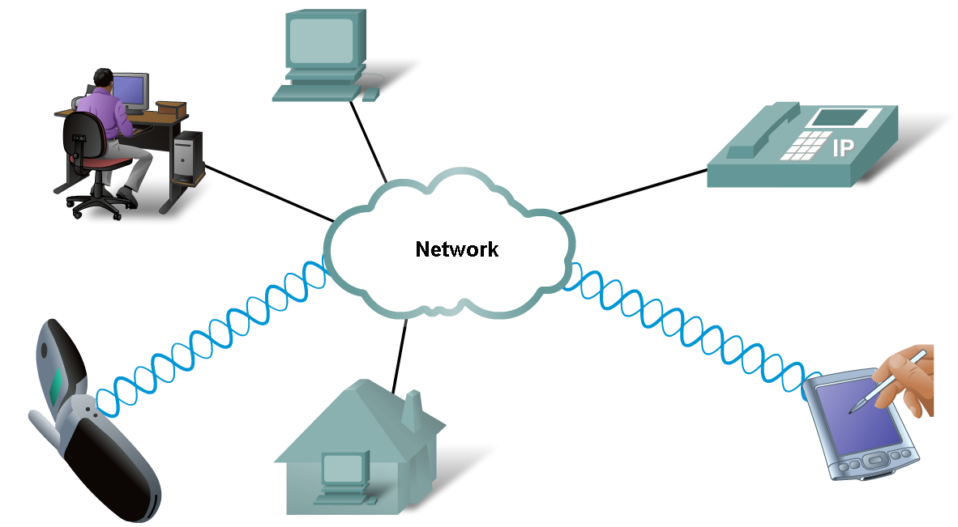
Technology Independent Protocols
Protocols are not dependent upon any specific technology.
  They describe what must be done to communicate but not how its is to be carried out.

Slide 18
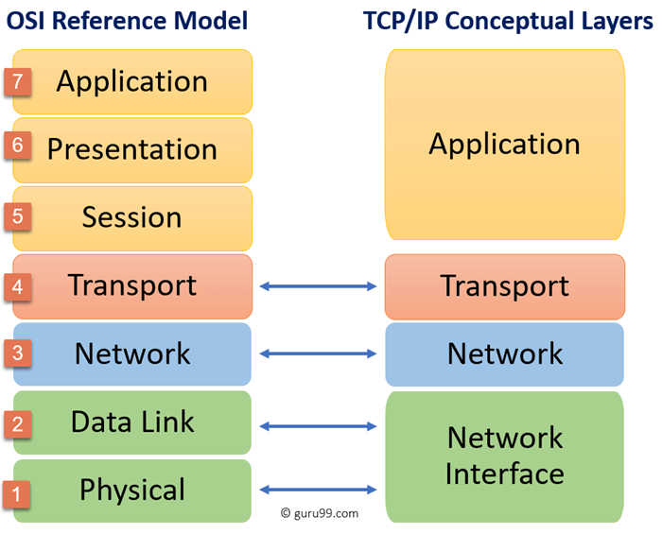
Protocol Suites

Slide 19
Protocol Suites
TCP/IP Protocol Model
  Open De Facto Standard
  Governed by IETF Working
  Groups
OSI Reference model
  De Jure Standard

Slide 20
OSI Model
De Jure Standard
Layers
7 | Application
6 | Presentation
5 | Session
4 | Transport
3 | Network
2 | Data Link
1 | Physical

Slide 21
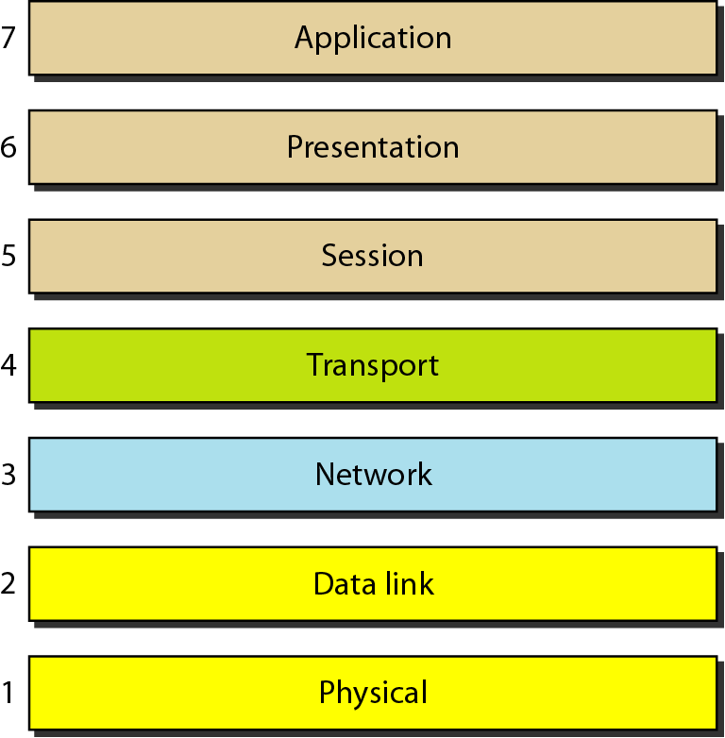
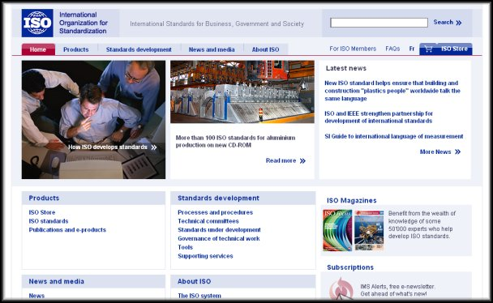
OSI Model
Open Systems Interconnection (OSI)
  Seven layers
  A theoretical system delivered too late!
  TCP/IP is the de facto standard
Developed by the International Organization for Standardization (ISO) in 1984.
ISO is the organization.
OSI is the model.

Slide 22
OSI Model - Layers
Primary Concern | Layers |  | Cisco
Communications between applications | 7 | Application | All
 | 6 | Presentation | People
 | 5 | Session | Seem
 | 4 | Transport | To
 | 3 | Network | Need
Moving raw data across the network | 2 | Data Link | Data
 | 1 | Physical | Processing

Slide 23
OSI Model - Layers
Primary Concern
Layers
Cisco
7
Application
A
ll
6
Presentation
P
eople
Communications
between
5
Session
S
eem
applications
4
Transport
T
o
3
Network
N
eed
Moving raw data
2
Data Link
D
ata
across the network
1
Physical
P
rocessing

Slide 24

An exchange using the OSI Model
Sender
Receiver
Layers
7 | Application
6 | Presentation
5 | Session
4 | Transport
3 | Network
2 | Data Link
1 | Physical
H7
D7
H7
D7
H6
D6
H6
D6
H5
D5
H5
D5
H4
D4
H4
D4
H3
D3
H3
D3
H2
D2
T2
H2
D2
T2
010
01010111100001101010101110011101
010
01010111100001101010101110011101
Transmission medium

Slide 25
Application Layer
- The 7th Layer of OSI Model
Sender
From Email/Other app
Receiver
To Email/Other app
Header
Data
Header
Data
To Presentation Layer
From Presentation Layer

Slide 26

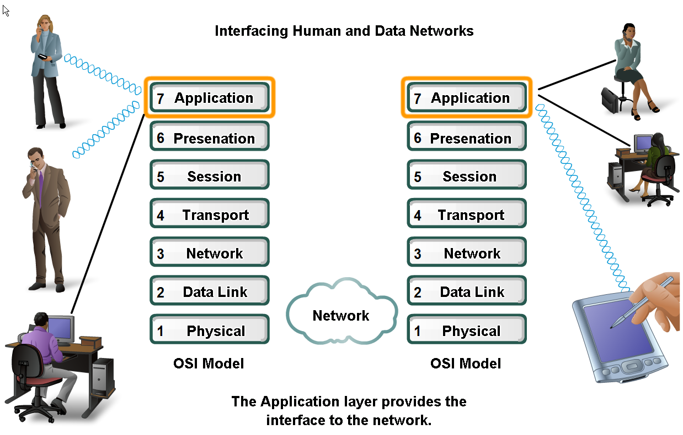

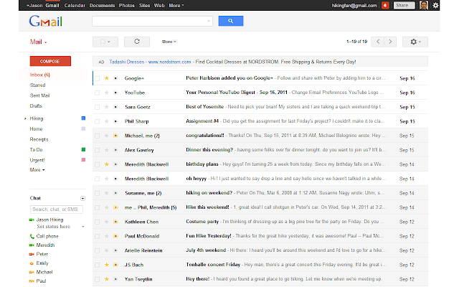
Applications
The Interface Between Human and Data Networks
Responsible for providing services to the user.
Browsers
Instant Messaging
Email

Slide 27
Examples: Application Layer Protocols
Application Layer | Name System | Host Config | Email | File Transfer | Web
 | DNS | BOOTP | SMTP | FTP | HTTP
 |  | DHCP | POP | TFTP | HTTPS
 |  |  | IMAP

Slide 28
Presentation Layer
- The 6th Layer of OSI Model
Sender
From Application Layer
Receiver
To Application Layer
Header
Data
Header
Data
To Session Layer
From Session Layer

Slide 29
Presentation Layer
The presentation layer is responsible for translation, compression, and encryption. i.e. the three primary functions
Presentation layer implementations are not typically associated with a particular protocol stack.

Slide 30
Session Layer
- The 5th Layer of OSI Model
Sender
From Presentation Layer
Receiver
To Presentation Layer
Header
Data
Header
Data
To Transport Layer
From Transport Layer

Slide 31
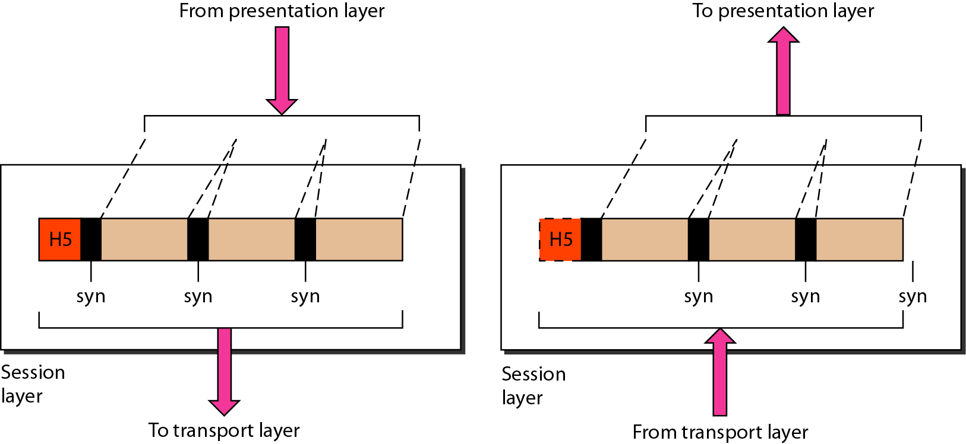
Session Layer
The session layer is responsible for dialog control and synchronization.
It handles the exchange of information
  to initiate dialogs
  keep them active, and
  to restart sessions that are disrupted or idle for a long period of time
Establish, Maintain, and Terminate Session
Dialog control: Half-duplex, full-duplex, simplex
Synchronization:
      Adds checkpoints (synchronization points) in long data streams.
      If a connection fails, communication can resume from the last checkpoint instead of starting over.
Most applications, like web browsers or e-mail clients, incorporate functionality of the OSI layers 5, 6 and 7.

Slide 32
Transport Layer
- The 4th Layer of OSI Model
Sender
From Session Layer
Receiver
To Session Layer
Header
Data
Header
Data
To Network Layer
From Network Layer

Slide 33
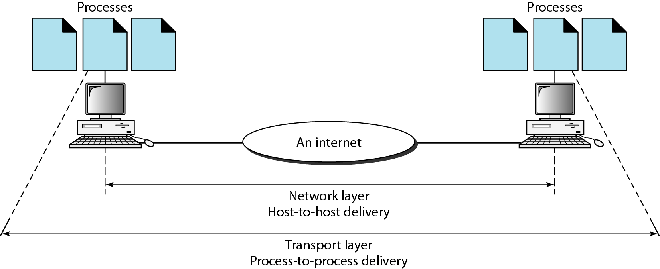
Transport Layer
The transport layer is responsible for the delivery of a message from one process (sender) to another (receiver).
Transport Layer PDU is called Segments
Functions:
  Segmentation and Reassembly
  Adds Port Address and Sequence Number.
  Connection Control
  Flow and Error Control
  Multiplexing
Notes
A common protocol used in Transport Layer is TCP.
*PDU – Packet Data Unit

Slide 35
Functions – Segmentation/Reassembly
Segments data received from application layer into small parts
Steps (Sender):
  Segments into small parts
  Add a number to identify the application
  Add a number sequence the segmented parts
What do you think will happen at the Receiver end?
  Uses the sequence number to order them sequentially, merges them and sends to the upper layer
H5
Data
Segments:
H4
D_1
H4
D_2
H4
D_3
H3
D_41
H3
D_42
H3
D_43
Legend
Session Layer
Transport Layer
Network Layer

Slide 36
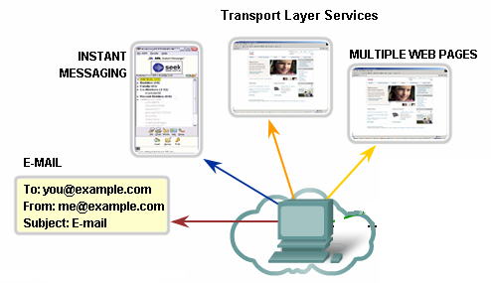
Function – Identification Using Port Address
Port Numbers/Addresses are used to identify different applications/processes running in a computer
16-bit in length
  Represented as one single decimal number
  e.g. 80 – Web; 23 – TCP;

Slide 37
Function – Connection Control
Establishes secure connection (TCP – Three Way Handshake)
Are you up?
Yes
1
2
3

Slide 38
Function – Flow Control
Establishes secure connection (TCP – Three Way Handshake)
At this point, this host has too many packets to process. Hence, the buffer to store incoming packets overflows.
Please, send less packets
1
2
3

Slide 39
Function – Error Control
Establishes secure connection (TCP – Three Way Handshake)
Please send Packet 2
Lost in transition
1
2
3
2
2

Slide 40
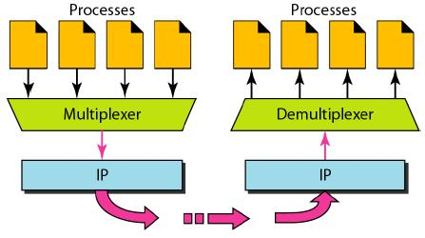
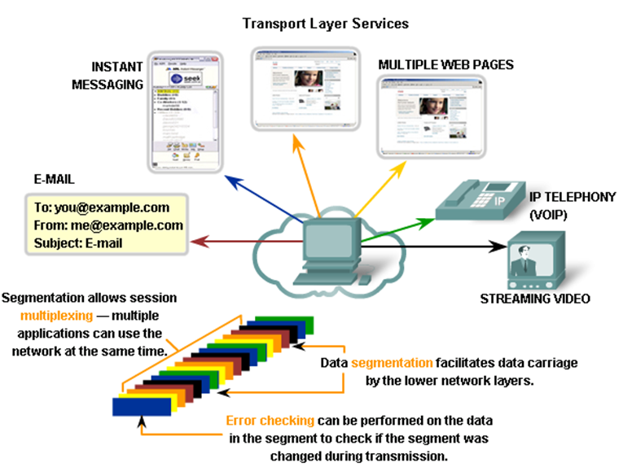
Function – Multiplexing

Slide 41
Network Layer
- The 3rd Layer of OSI Model
Sender
From Transport Layer
Receiver
To Transport Layer
Header
Data
Header
Data
To Data Link Layer
From Data Link Layer

Slide 42
Network Layer
Network Layer PDU is called Packet.
The network layer is responsible for the delivery of individual packets from the source host to the destination host.
Common Network Layer Protocol is called Internet Protocol (IP)
Functions :
  Adds an address (Logical Address) to identify sender and receiver hosts.
  Decides which path to take (Routing).

Slide 43
Network Layer – Logical Address
Universal address, each host uniquely defined.
32-bit address also known as IP Address.
  The bits are written in dotted decimal notation. Each decimal represented by 8 bits.
  Example: 192.168.10.1
Independent of underlying physical networks.

Slide 44
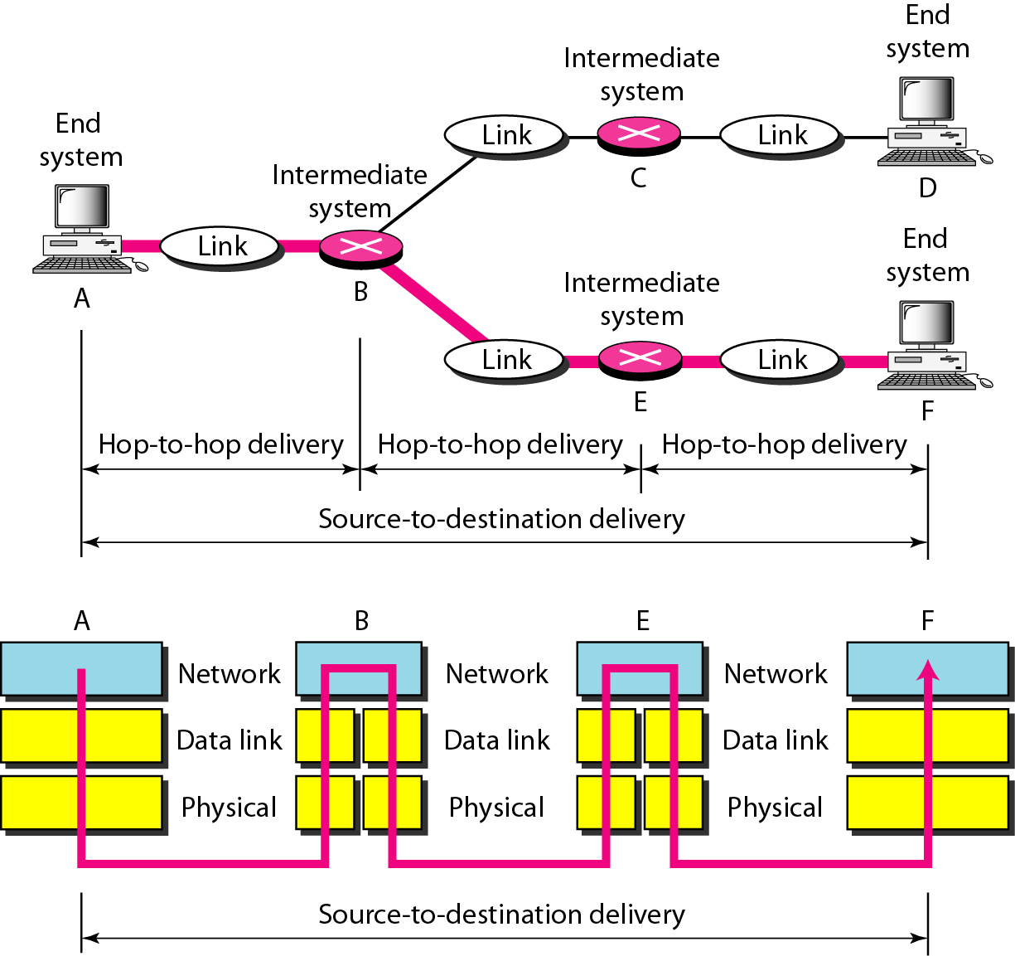
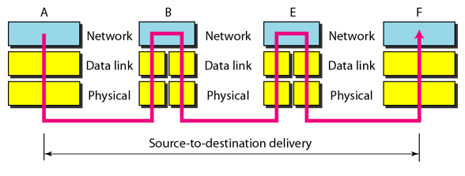
Network Layer - Example
  A,B,C,D,E and F are Logical addresses
  Packet to be delivered from A to F

Slide 45
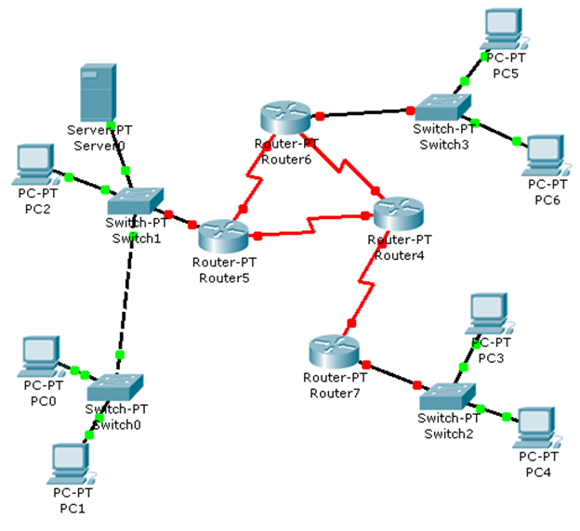
Network Layer – Another Example
LAN 1
LAN 2
Inter-connections
?
?
?
?
LAN 3
Receiver
Sender

Slide 46
Data Link Layer
- The 2nd Layer of OSI Model
Sender
From Network Layer
Receiver
To Network Layer
Header
Data
Trailer
Header
Data
Trailer
To Physical Layer
From Physical Layer

Slide 47
Data Link Layer Layer
Data Link Layer PDU is called Frame.
The data link layer is responsible for moving frames from one hop (node) to the next.
Protocols on this layer varies.
Functions :
  Framing
  Physical Addressing
  Flow Control
  Error Control
  Access Control
From Network Layer
Header
Data
Trailer
To Physical Layer

Slide 48
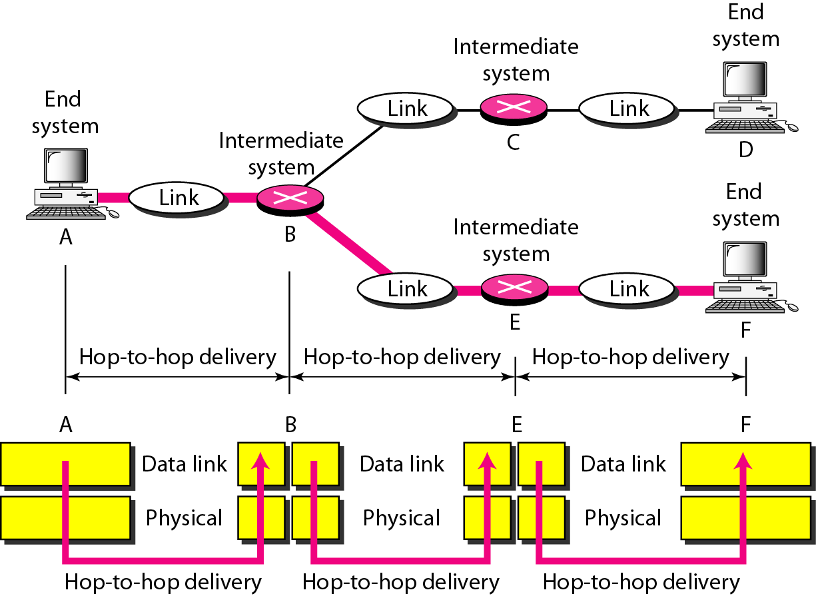
Hop-to-Hop Delivery

Slide 49
Data Link Layer – Physical Address
Also known as MAC (Media Access Control) Address
Every interface/port/device has an unique identifying number.
  Given by manufacturer.
48 bits long, represented by 12 hexadecimal digits grouped in pairs and separated by ‘–’ or ‘:’ .
  Example: 07:01:02:01:2C:4B

Slide 50
Physical Layer
- The 1st Layer of OSI Model
Sender
From Data Link Layer
Receiver
To Data Link Layer
0011010100
010100001111100110110111101010101001
0011010100
0101000011111001101101111010101010
To transport medium
From transport medium

Slide 51
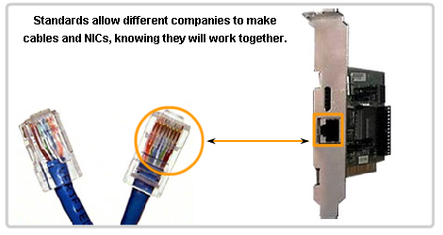
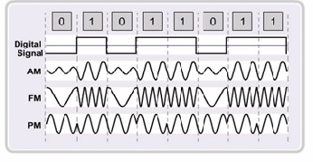
Physical Layer
The physical layer is responsible for movements of individual bits from one hop (node) to the next.
Functions
  Physical Characteristics of interfaces and medium.
  Representation of bits
  Data Rate
  Synchronization of bits

Slide 52
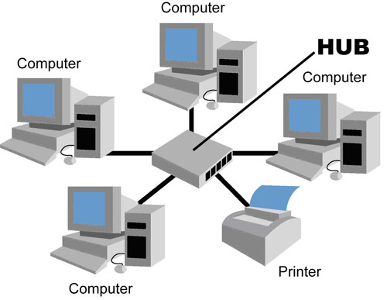
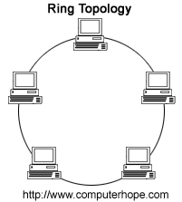
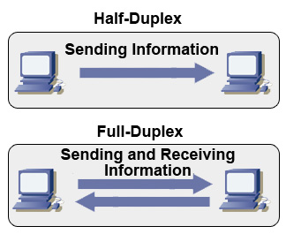
Physical Layer
Physical Topology
  Example: Bus, ring, etc.
Transmission Modes
  Simplex
  Half Duplex
  Full Duplex

Slide 53
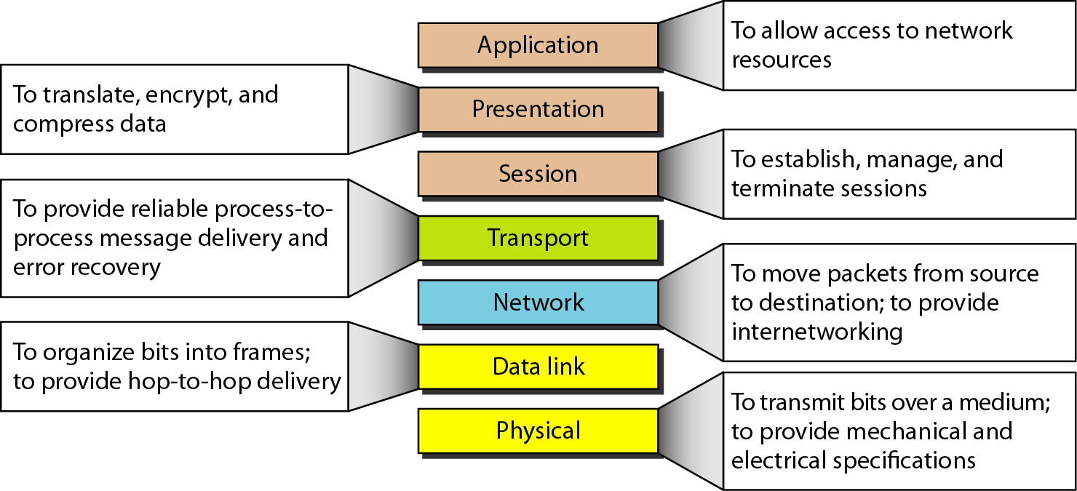
Summary of OSI Layers

Slide 54
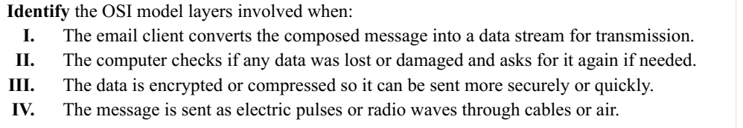
Application Layer
Transport layer
Presentation layer
Physical layer

Slide 55
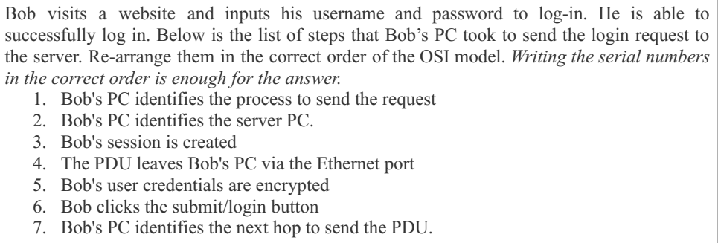
6
5
3
1
2
7
4

Slide 56
TCP/IP Model
De Facto Standard
OSI Model |  | TCP/IP Model
7 | Application | Application
6 | Presentation
5 | Session
4 | Transport | Transport
3 | Network | Internet
2 | Data Link | Network Access
1 | Physical

Slide 57
TCP/IP Model
Developed by the US Defense Advanced Research Project Agency (DARPA) for its packet switched network (ARPANET)
Used by the global Internet.
Also known as De Facto Standard.
OSI Model |  | TCP/IP Model
7 | Application | Application
6 | Presentation
5 | Session
4 | Transport | Transport
3 | Network | Internet
2 | Data Link | Network Access
1 | Physical

Slide 58


TCP/IP Encapsulation and PDU
PDU
Email Data
Data
Data
Data
Data
Transport Header
Data
Segment
Passing down the stack
Network
Header
Transport Header
Data
Packet
Frame
Header
Network
Header
Transport Header
Data
Frame
Trailer
Frame (Medium Dependent)
10011010111010101010101010101010101011010101010101010
Bits

Slide 59
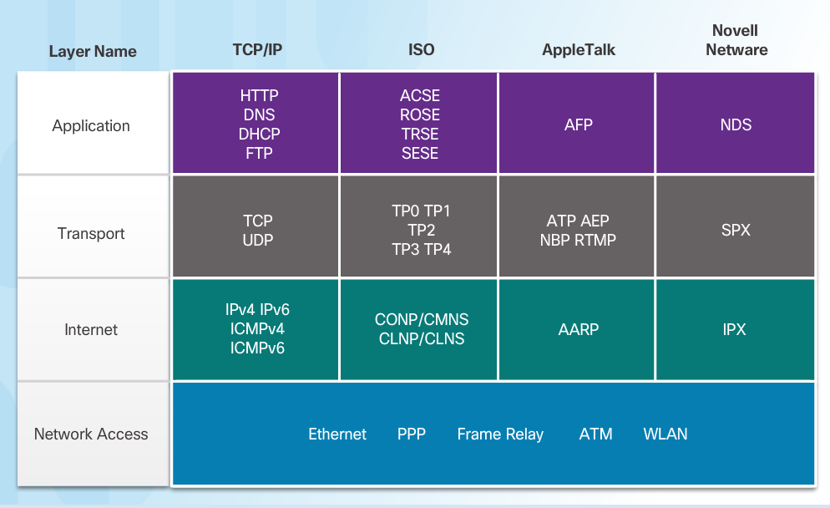
TCP/IP and Other Models

Slide 60
Addressing in Networking

Slide 61
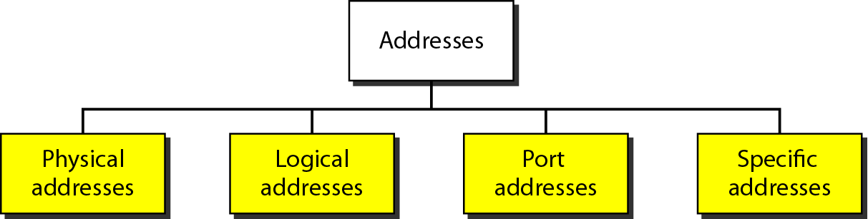
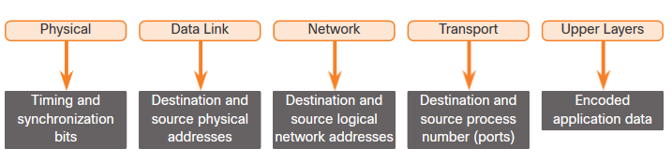
Addressing - Summary
Four levels of addresses are used in an internet employing the TCP/IP protocols

Slide 62
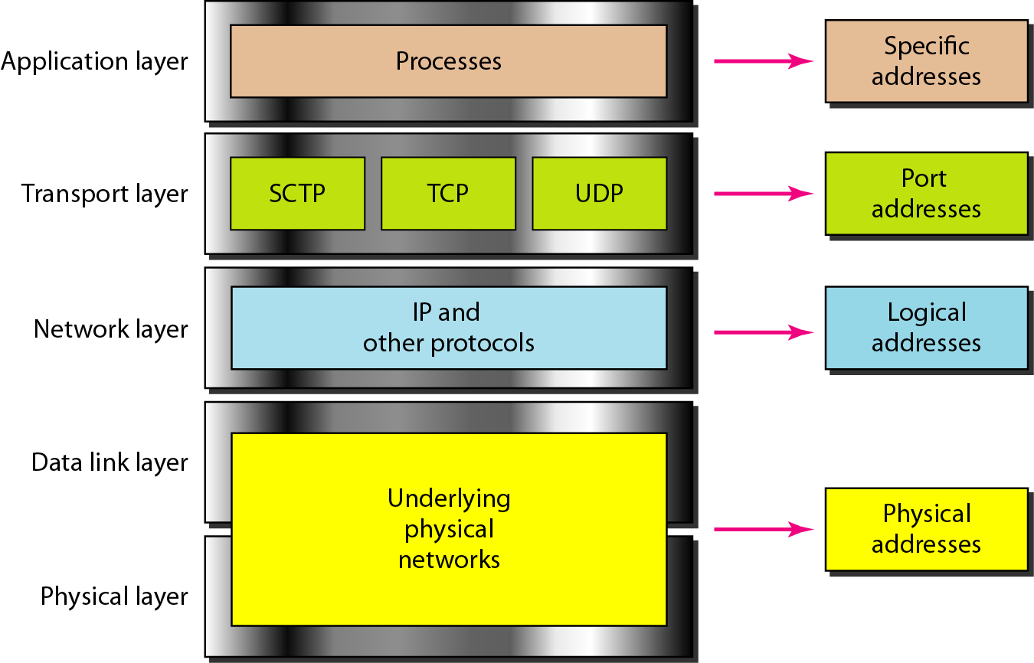
Relationship of layers and address in TCP/IP

Slide 63
Addresses
Specific Address
  Applications having user friendly addresses.
  Email addresses or URLs.
    john@gmail.com or www.bracu.ac.bd
  Theses are converted into corresponding port and logical addresses by the sending computer.
The other addresses are already discussed in the earlier slides! Can you identify them?
**Port address (Slide 35), Logical Address (Slide 42), Physical Address (Slide 48)

Slide 64
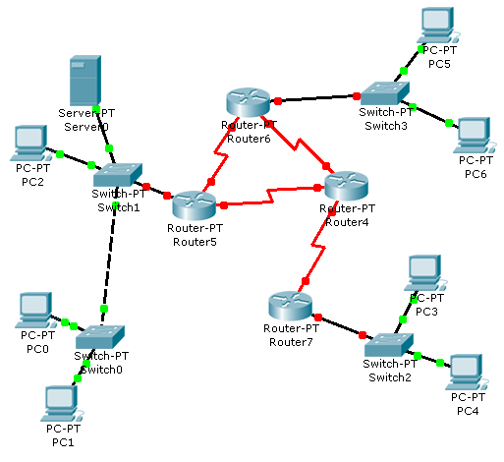
Logical and Physical Address – Same Network
Legend:
IP Addresses – Numbers
MAC Address – Alphabets
4/D
3/E
Receiver
5/A
2/C
D S S D
Sender
1/B
E
B
1
3
Data

Slide 65
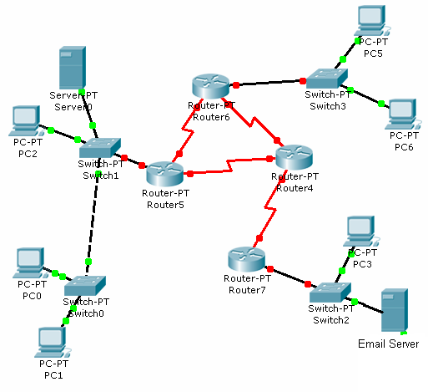
Port, Logical & Physical Address – Different Network
Legend:
IP Addresses – Numbers
MAC Address – Capital Alphabets
Port Address – Small Alphabets
G
J
A
F
0
a
k
L
H
B
1
Data
K
4/D
D S S D S D
3/E
5/A
9/H
6/F
8/J
2/C
7/G
0/L
D S S D
10/K
Receiver
Sender
1/B
Email – a
Web – c
Email – k

Slide 66
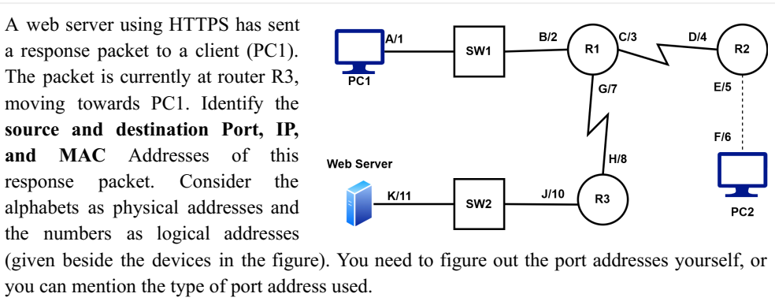
IP address: 11, 1 (never change)
MAC address: H, G (change in every hop (in every router))
Port address : 443, 50001 (Never change)

Slide 67
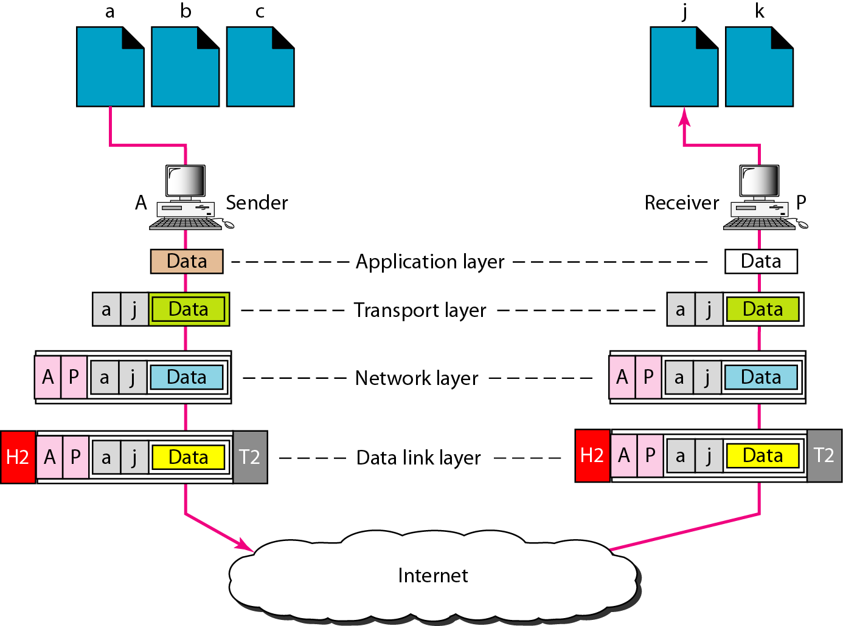
Addressing – Review
Although physical addresses change from hop to hop, logical and port addresses remain the same from the source to destination.

Slide 68
The End
References
  [1] Chapter 2, The McGraw-Hill Companies, Inc.
  [2] Chapter 3,The McGraw-Hill Companies, Inc.
  [3] CCNA 1, CISCO.

